Slide 1
CHAPTER
THE CHEMICAL & MOLECULAR BASIS OF LIFE
Roselyn A. Naranjo
USPF, College of Pharmacy
www.roselynnaranjo.vze.com
roselean@gmail.com

Slide 2
SPECIFIC OBJECTIVES
To understand the nature of life & the substances involved in the process of living
To differentiate between inorganic & organic compounds
To explain the role of water in maintaining life
To apply the knowledge of biochemical processes to commercial concepts

Slide 3
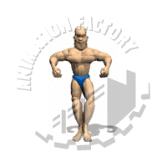
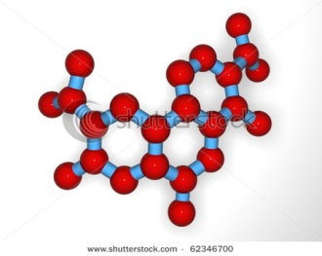
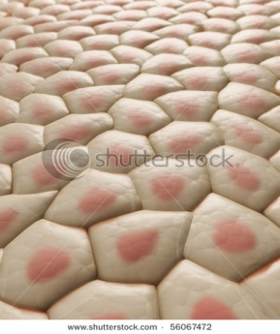
THE ATOMIC STRUCTURE
Matter
Atom
Molecule
Cell
Muscle
Compound
Tissue

Slide 4
THE ATOMIC STRUCTURE
Forms of Matter
Na
Na
ELEMENT
Composed of only one kind of atom
Na
Na
Na
Na
Na
Composed of two or more elements of different kinds
O
COMPOUND
H
H
MIXTURE
Contains two or more substances mixed together but not chemically combined
C₁₂ H₂₂ O₁₁

Slide 5
THE ATOMIC STRUCTURE
Composition of an ATOM
-
-
-
-
-
-
-
-
-
-
0
+
0
-
-
+
+
-
-
protons
-
+
+
0
-
0
0
+
-
-
-
+
0
+
-
-
0
0
neutrons
+
0
+
-
-
-
-
-
-
-
-
-
-
-
electrons
-
The Nucleus

Slide 6
THE ATOMIC STRUCTURE
Elements & Compounds
98%
Carbon, Hydrogen, Oxygen & Nitrogen
(insert photo here)
2%
Ca, P, I, S, Fe, Zn, Na, Cl, F, Cu, K

Slide 7
THE ATOMIC STRUCTURE
Chemical Bonds
Ionic Bond
..
Complete transfer of electron from one atom to another
..
: :
..
: :
.
.
.
.
.
.
:
Na
Cl
..
..
..
SODIUM donated to CHLORINE
Complete transfer of electrons

Slide 8
THE ATOMIC STRUCTURE
Chemical Bonds
Covalent Bond
Sharing of electrons between atoms
Polar
. .
.
.
O
H
Different atoms share an electron
H
HYDROGEN shared electrons to OXYGEN
Sharing of electrons

Slide 9
THE ATOMIC STRUCTURE
Chemical Bonds
Covalent Bond
Sharing of electrons between atoms
Non-Polar
:
:
O
O₂
O
Same atoms share an electron
2 OXYGEN shared electrons to form a dipolar molecule
Sharing of electrons

Slide 10
THE ATOMIC STRUCTURE
Chemical Bonds
Covalent Bond
Sharing of electrons between atoms
.
Hydrogen Bonds
H
.
.
C
.
Weakest & most important bonds in biological system
.
HYDROGEN shared electrons to CARBON
Sharing of electrons

Slide 11
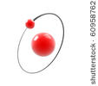
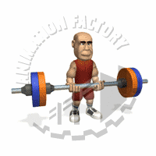
BIOCHEMICAL REACTIONS of the LIVING ORGANISMS
..mainly composed of ....
CARBON
HYDROGEN
All
living organisms
OXYGEN
PHOSPHORUS
NITROGEN
SULFUR

Slide 12
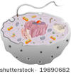
BIOCHEMICAL REACTIONS of the LIVING ORGANISMS
PROTOPLASM
Composed of :
Carbohydrates
O
O
H
H
Proteins
H
H
O
O
H
H
O
Lipids
H
H
H
H
O
O
Nucleic Acids
H
H
H
H

Slide 13
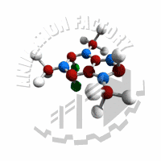
BIOCHEMICAL REACTIONS of the LIVING ORGANISMS
building blocks
Carbohydrates
Composed of
C
Simple
SUGARS
O
Provides energy to the body
H
Classification
MONOSACCHARIDES
One sugar unit
Example
Glucose
Grapes, blood
Fructose
Honey, fruits
Galactose
milk

Slide 14
BIOCHEMICAL REACTIONS of the LIVING ORGANISMS
building blocks
Carbohydrates
Composed of
C
Simple
SUGARS
O
Provides energy to the body
H
Classification
DISACCHARIDES
Two sugar units
Glucose + Fructose
Example
Sucrose
Table sugar
Beer, milkshake,cereals, grains
Maltose
Glucose + Glucose
Milk
Lactose
Glucose + Galactose

Slide 15
BIOCHEMICAL REACTIONS of the LIVING ORGANISMS
building blocks
Carbohydrates
Composed of
C
Simple
SUGARS
O
Provides energy to the body
H
Classification
POLYSACCHARIDES
Two or more sugar unit
Example
Starch
storage form of glucose in plants
Cellulose
Abundant material in cell wall
Primary form of glucose storage in animals
Glycogen
CHITIN – polysaccharide found in the exoskeleton of crustaceans & insects

Slide 16
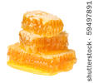
BIOCHEMICAL REACTIONS of the LIVING ORGANISMS
building blocks
Referred as
Lipids
STEROIDS
Composed of
C
OILS
CHOLESTEROL
O
GLYCEROL
H
WAX
Kinds of FATS
SATURATED
UNSATURATED
Example
Margarine
Example
Vegetable oil
remain solid at room temperature
Easily converted into cholesterol
Becomes liquid at room temperature

Slide 17
BIOCHEMICAL REACTIONS of the LIVING ORGANISMS
building blocks
Referred as
Lipids
STEROIDS
Composed of
C
OILS
CHOLESTEROL
O
GLYCEROL
H
WAX
Kinds of FATS
SATURATED
Accumulation of CHOLESTEROL in the walls of arteries reduces blood flow & increases blood pressure, which will result to a condition called ARTERIOSCLEROSIS
Example
Margarine
Easily converted into cholesterol

Slide 18
BIOCHEMICAL REACTIONS of the LIVING ORGANISMS
Lipids
building blocks
Referred as
Lipids
STEROIDS
Composed of
C
OILS
CHOLESTEROL
O
GLYCEROL
H
WAX
Kinds of FATS
PHOSPHOLIPIDS
Important compounds in
cell membrane

Slide 19
BIOCHEMICAL REACTIONS of the LIVING ORGANISMS
Lipids
building blocks
Referred as
Lipids
STEROIDS
Composed of
C
OILS
CHOLESTEROL
O
GLYCEROL
H
WAX
Functions
Storage molecule of energy
Serve as waterproof material in some plants & animals
Provides mechanical protection to internal organs such as the heart & visceral organs

Slide 20
BIOCHEMICAL REACTIONS of the LIVING ORGANISMS
building blocks
Body-building molecules
Proteins
Composed of
C
O
AMINO ACIDS
P
S
H
N
Functions
Transport Oxygen & Carbon dioxide
Serve as catalyst in the body’s chemical reactions in a form of ENZYMES
Provides structure to different organs in the body
Responsible for the contraction of muscle

Slide 21
BIOCHEMICAL REACTIONS of the LIVING ORGANISMS
building blocks
Body-building molecules
Proteins
Composed of
C
O
AMINO ACIDS
P
S
H
N
Functions
Protect the body against infection in a form of WBC
Give color to the skin
Basic components of the cell

Slide 22
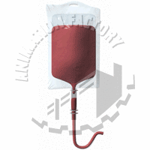
BIOCHEMICAL REACTIONS of the LIVING ORGANISMS
Proteins
Example
Hemoglobin
Collagen
BLOOD
Keratin
HAIR
SKIN
Actin & Myosin
Hormones
Catalyst
MUSCLE
CHEMICAL REACTION
MOOD

Slide 23
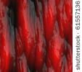
BIOCHEMICAL REACTIONS of the LIVING ORGANISMS
Groups of PROTEINS
Proteins
GLOBULAR PROTEINS
Forms a spherical shape
Example
Red & White Blood Cells
FIBROUS PROTEINS
Forms a long & parallel groups of protein, they are insoluble
Feather, Nails, Hair, Hooves & tissues

Slide 24
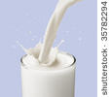
BIOCHEMICAL REACTIONS of the LIVING ORGANISMS
Proteins
Common SOURCES
EGG WHITE
BLOOD
FLOUR
MEAT
MILK
NAILS
SKIN

Slide 25
BIOCHEMICAL REACTIONS of the LIVING ORGANISMS
Nucleic Acid
building blocks
PHOSPHATE
SUGAR
BASE
NUCLEOTIDES
Types of Nucleotides
DNA
Found in the nucleus of the cell; part of chromosome structure
Replicates the genetic code

Slide 26
BIOCHEMICAL REACTIONS of the LIVING ORGANISMS
Nucleic Acid
building blocks
PHOSPHATE
SUGAR
BASE
NUCLEOTIDES
Types of Nucleotides
RNA
Carry te message directed by the DNA to the Ribosomes
Found in the cytoplasm
Involved in protein synthesis

Slide 27
BIOCHEMICAL REACTIONS of the LIVING ORGANISMS
Basic food material for all
living organisms
Vitamins
Promotes growth & development of tissues and prevent disease
Classification of Vitamins
Water Soluble
Vitamin B-Complex & Vitamin C
Fat Soluble
Vitamins A,D,E & K
Refer to Page 19 for Functions

